Slide 1
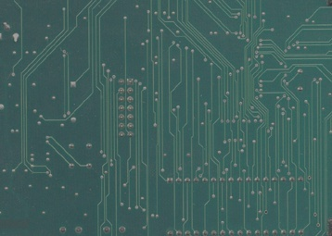
Operating Systems
Lecture#1
Course Outline/Intro,
CPU and its Parts
Computer System,
Operating systems, Types,
Functions

Slide 2
Text Book
Modern Operating System By Tanenbaum A.S.
Helping Book
Operating Systems: Internals and Design Principles By William Stalling

Slide 3
ORIENTATION

Slide 4
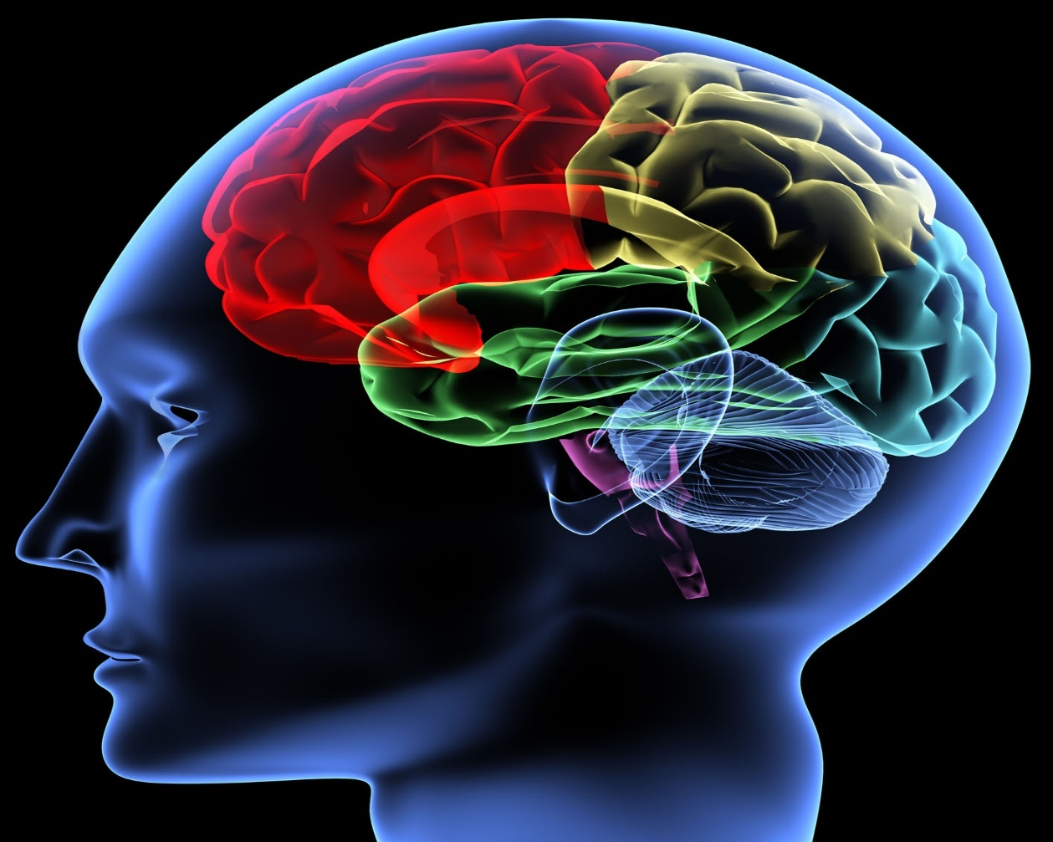
How do we understand an OS?
We need an “Operating SYSTEM” in order to understand a signal, in our case it is our brain to which an input signal is conveyed via our eye.

Slide 5

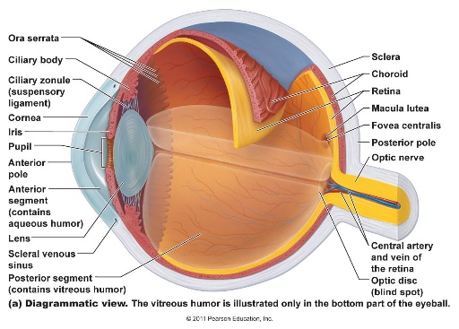
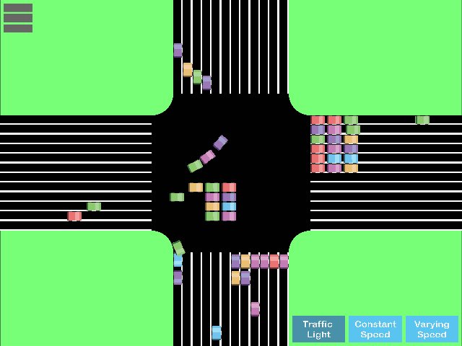

An Example
Signal
Input
Operating
System
Respond

Slide 6
Overview to Basics

Slide 7
What is a CPU?
CPU(Central processing Unit): Brain of computer where calculations and decision are made. It is also called microprocessor.
Three parts of CPU:
  ALU: Performs mathematical and logical operations
  CU: Interconnect CPU to other parts and control traffic.
  Memory: Storage area, temporary or permanent. RAM,ROM and Hard disk.

Slide 8
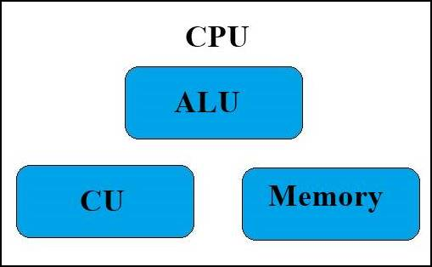
What is a CPU?

Slide 9
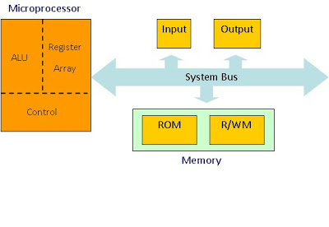
How CPU works?

Slide 10
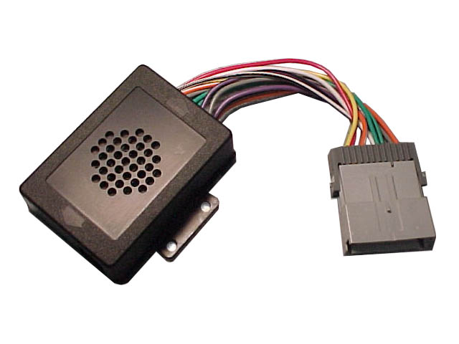
What is Bus?
A bus in computer terms, is simply a channel over which information flows between two or more devices.
There are three types of bus:-
  Address bus
  Data bus
  Control bus

Slide 11
Memory
Memory is one of the most important factor in the microprocessor.
It is used to store the data or information in a binary format.
Memory can be permanent such as hard disk or it can be temporary such as RAM.
Register is the smallest memory unit.

Slide 12
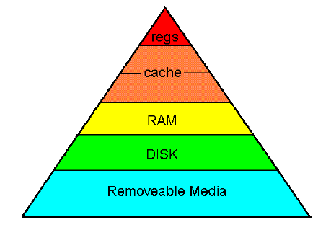
Memory Hierarchy

Slide 13
Fetch Execute Cycle

Slide 14
Fetch Execute Cycle
Fetch: The Fetch Operation is used for taking the instructions/data those are given by the user and the Instructions/data those are stored into the Memory will be fetched.
Decode: The Decode Operation is used for interpreting the Instructions, which means that the Instructions are decoded. In this way, the CPU will find out which Operation is to be performed on the Instructions.
Execute: The Execute Operation is performed by the CPU. The Results produced by the CPU are then Stored into the Memory and after that they are displayed on the user Screen.

Slide 15
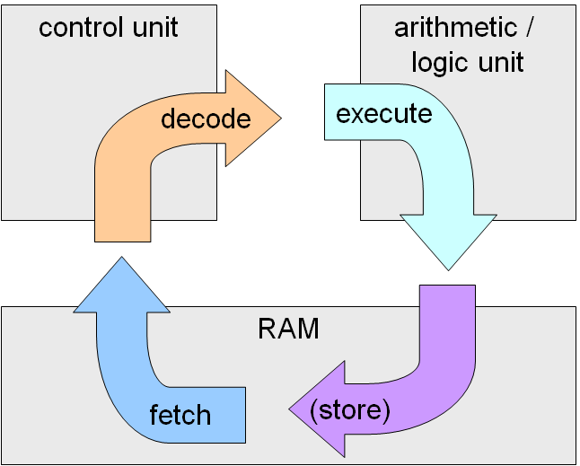
HOW ALU,CU AND REGISTER ARE WORKING TOGETHER

Slide 16
Introduction to Computer System

Slide 17
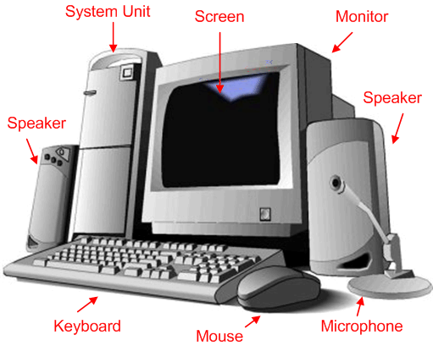
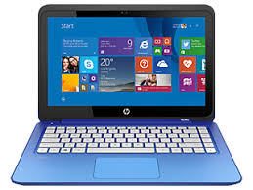
What is Computer System

Slide 18
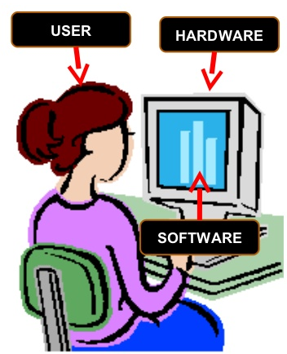
What is Computer System: Definition
Computer system is defined as the combination of hardware, software, and data.

Slide 19
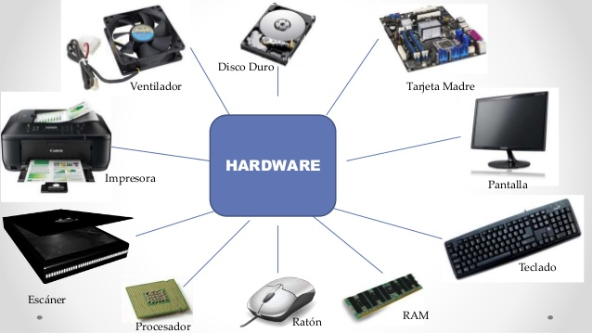
What is Computer System: Hardware
Computer hardware is the physical parts or component of a computer, such as monitor, keyboard, computer data storage, graphic card, sound card, motherboard, and so on.

Slide 20
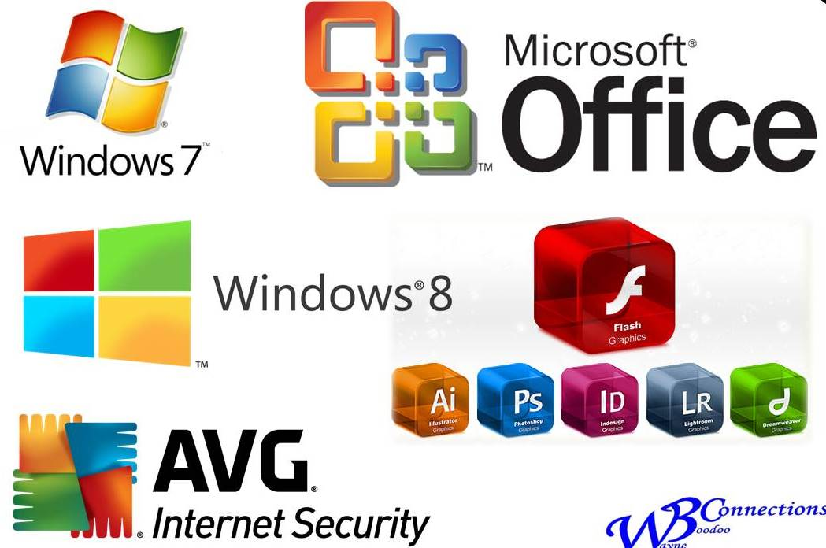
What is Computer System: Software
A computer software, or simply software, is a part of a computer system that consists of data or computer instructions.
Further divided as system or application software.
Windows is ?

Slide 21
What is Computer System: User and Data
A user is a person who uses a computer or network service.
Users generally use a system or a software product without the technical expertise required to fully understand it.
Computer data is information processed or stored by a computer. This information may be in the form of text documents, images, audio clips, software programs, or other types of data.
Computer data may be processed by the computer's CPU and is stored in files and folders on the computer's hard disk.

Slide 22
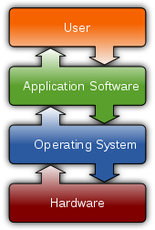
What is Computer System: How computer System Works?
A user interacts with a computer via operating system as a medium.

Slide 23
Operating System

Slide 24
Operating System: Definition
An Operating System (commonly abbreviated as OS & O/S) is an integrated set of programs which controls the overall operations of the computer system and acts as a layer between the hardware, applications and users.
In simplest terms, an operating system is a collection of programs that manage a computer system's internal workings— its memory, processors, devices, and file system.

Slide 25
Operating System: Function performed by OS
Device configuration
Controls peripheral devices connected to the computer
File management
Transfers files between main memory and secondary storage, manages file folders, allocates the secondary storage space, and provides file protection and recovery
Operating
System
Memory management
Allocates the use of random access memory (RAM) to requesting processes
Interface platform
Allows the computer to run other applications

Slide 26
Operating System: Function performed by OS
Memory management
Disk management
File management
Provide working environment to the users
Handling I/O devices
Handling security
Scheduling
Copying/Moving data from one device to another

Slide 27
Operating System: Advantages
Hides the messy details which must be performed
(e.g. underlying hardware operations).
Provide a GUI(Graphical User Interface), make it easier to use.
Process management, (CPU) each program gets time with the resource
Memory management, (memory / disk) each program gets space on the resource

Slide 28
Operating System: Remember!
Remember an operating system is a “System Software”.

Slide 29
Operating System: Examples
Microsoft Operating System
Disk Operating System (MS-DOS)
Windows Vista
Windows XP
Windows 2000
Windows 98
Windows 7,8,10

Slide 30
Operating System: Other Examples
UNIX
LINUX
Apple Mac OS
Ubuntu

Slide 31
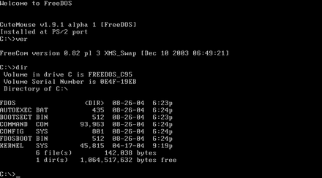
Operating System: DOS OS

Slide 32
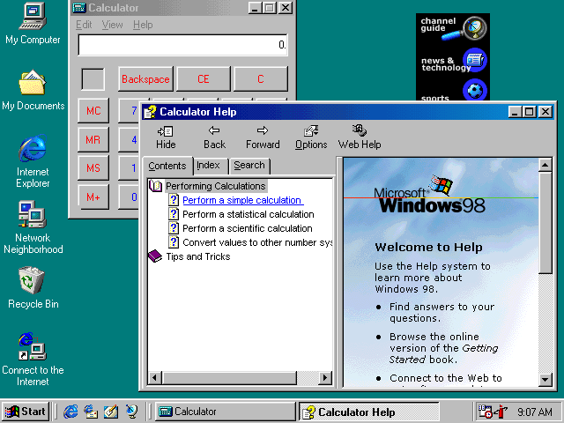
Operating System: Windows 98,(GUI) Based

Slide 33
Types of Operating System

Slide 34
Types of Operating System
Some types of operating systems are:
Mainframe OS
Server OS
Multiprocessor OS
PC OS
Real Time OS
Embedded OS
Networking OS

Slide 35
Types of OS: Main Frame OS
A mainframe operating system runs on a mainframe computer.
Mainframe computer is a powerful device used mainly by governments and businesses to process large amounts of information and support a great number of users.
Example : OS used by banks are composed of mainframe OS.

Slide 36
Types of OS: Networking OS
A Networking Operating System (NOS) runs on a main server and enables the server to manage data, users, groups, security, applications, and other networking functions.
The network operating system is designed to allow shared file and printer access among multiple computers in a network, typically a local area network (LAN), a private network or to other networks.
Examples
Microsoft Windows Server 2003, Microsoft Windows Server 2008, UNIX, Linux, Mac OS, and Novell NetWare.

Slide 37
Types of OS: Distributed OS
  It manages a group of independent computers and makes them appear to be a single computer.
  The development of networked computers that could be linked and communicate with each other, gave rise to distributed computing.
  Distributed computations are carried out on more than one machine. When computers in a group work in cooperation, they make a distributed system.

Slide 38
Types of OS: Real-Time OS
  A real-time operating system is a multitasking operating system that aims at executing real-time applications.
  The main objective of real-time operating systems is their quick and predictable response to events.

Slide 39
Types of OS: Real-Time OS(Examples)

Slide 40
Types of OS: Embedded OS
  They are designed to operate on small machines like mobile phones, PDAs, etc.
  They are able to operate with a limited number of resources. They are very compact and extremely efficient by design.
  Examples
  Palm OS, Android

Slide 41
Special Functions of Operating System

Slide 42
Time sharing Process
In case of multiple users, each user is given a time slice to interact with the CPU.
The size of the time slice will depend on the system.
Each user is served in sequence.
For example multiple users using printer connected to a pc in LAN network.

Slide 43
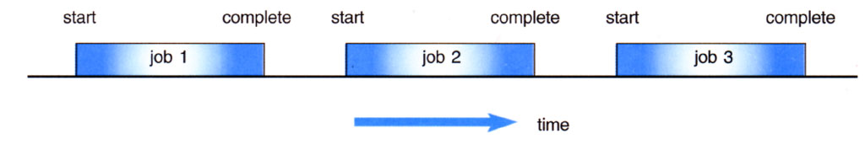
Batch Processing
Jobs, together with input data, are fed into the system in a batch.
The jobs are then run one after another.
No job can be started until previous job is completed

Slide 44
Other special Function performed by OS
Multi-tasking
Multi-programming
Parallel processing
Buffering
Spooling

Slide 45
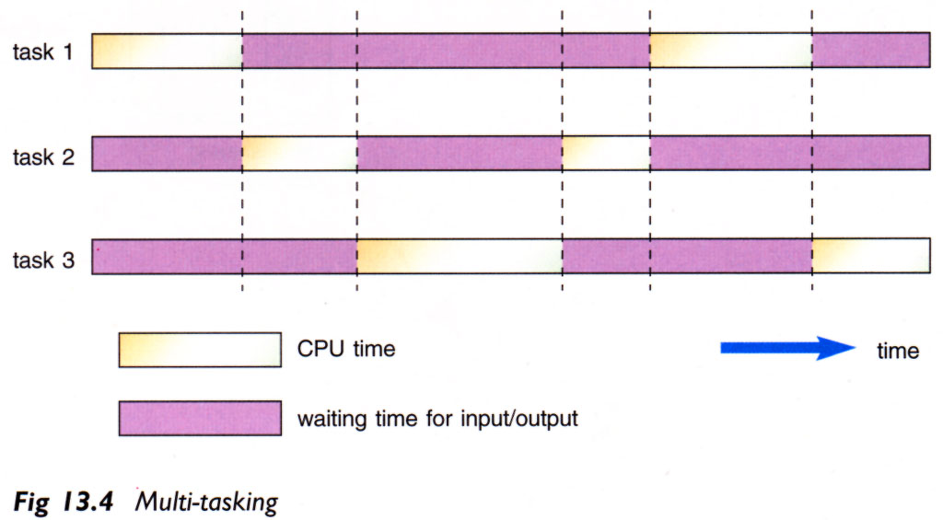
Multi Tasking
To handle two or more programs at the same time from a single user ‘s perception

Slide 46
Multi Programming
Two or more programs store in the main memory(RAM) at the same time
When one job needs to wait (e.g. I/O operation), CPU switch to another job to execute
When the first job finishes waiting, CPU will get back the first job to execute

Slide 47
Parallel Programming
Using two or more CPUs to handle jobs
without multiprocessing
with multiprocessing
Job 4
Job 3
Job 4
Job 2
time
Job 3
time
Job 1
Job 1
Job 2
CPU 1
CPU 2
CPU 1

Slide 48
Buffering
A temporary storage area (buffers) to read data from input device or send data to the output device

Slide 49
Spooling
Definition: Spooling is a simultaneous I/O devices operations where a process put jobs in a buffer or temporary storage area, a special area in memory or on a disk and device can access them when it is ready.
Spooling is useful because different devices access data at different rates.

Slide 50
Spooling: An Example
The most common spooling application is print spooling. When you choose to print a document, the computer sends the document information to the printer very quickly, but the printer can't accept it at the same rate.
The printer can only handle a chunk of information at a time, and it pauses to process and print that chunk before it's ready for more.
Meanwhile, you have to wait until the printer has accepted the whole document, piece by piece.

Slide 51


